Slide 1
USING DSIDES
BRIEF
Warren Smith

Slide 2


TO USE DSIDES – SRL@OU
MinGW – GNU Fortran
(command / run environment)
Programmer’s Note Pad
(suggested programming editor)
Work and Run codes from user’s own directories
(C:\Users\4x4)
Copy required files from
C:\DSIDES_USER
DONOT modify /delete / move any files in directories
C:\DSIDES_SRL
C:\DSIDES_USER

Slide 3
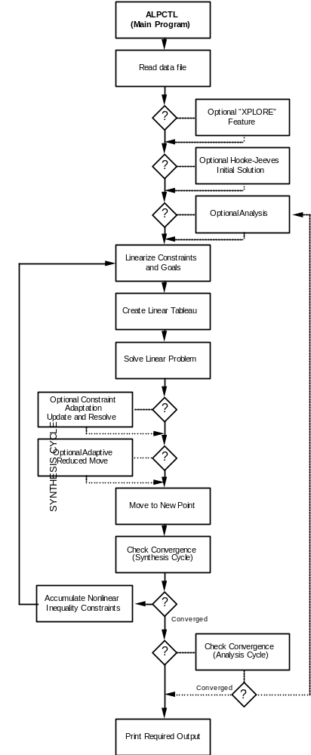
FLOWCHART

Slide 4
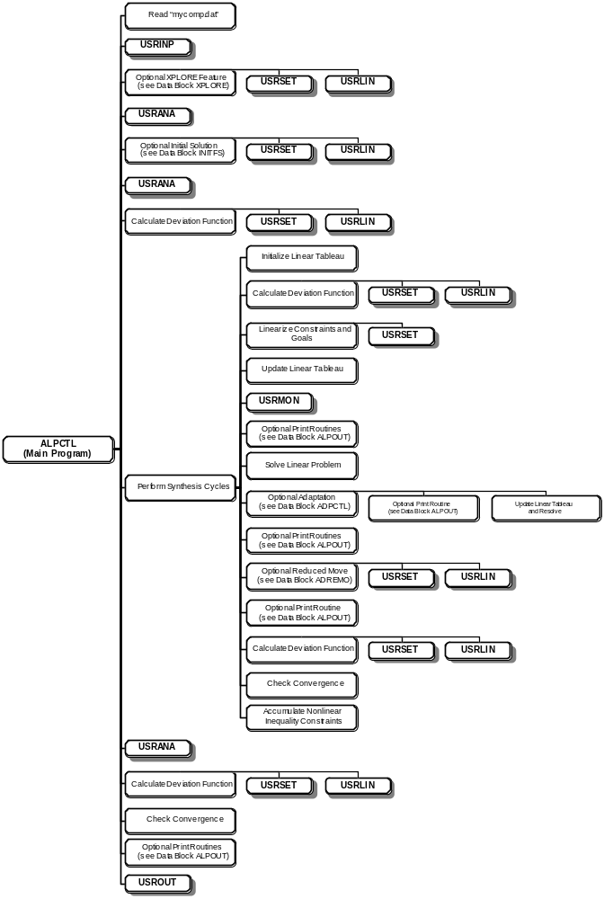
FLOWCHART

Slide 5
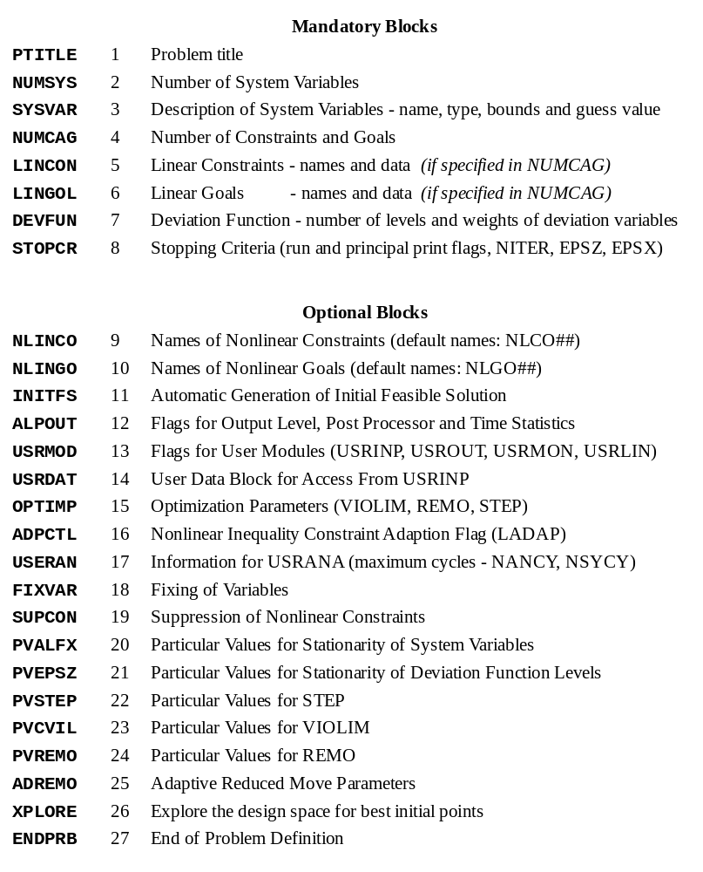
DATA

Slide 6
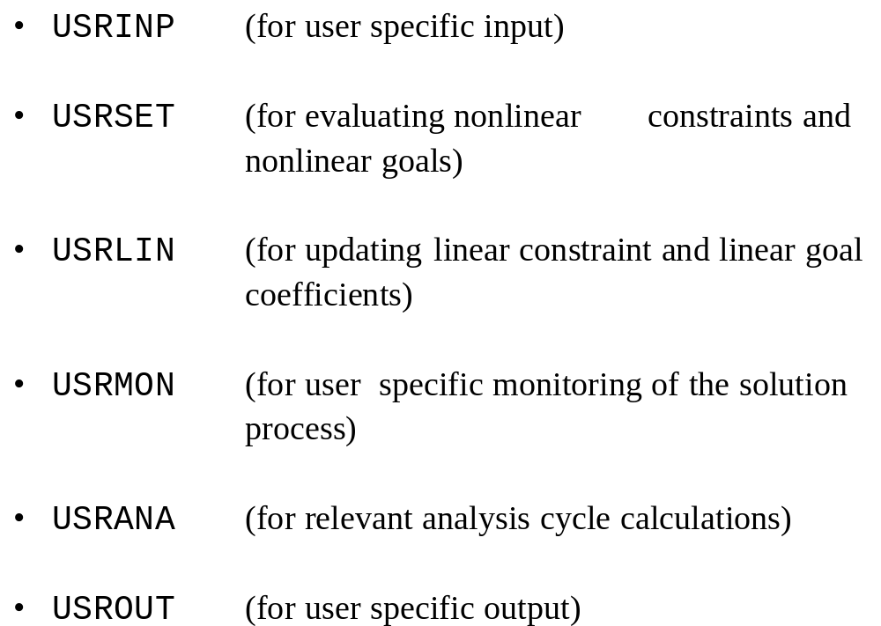
USER SPECIFIED ROUTINES

Slide 7
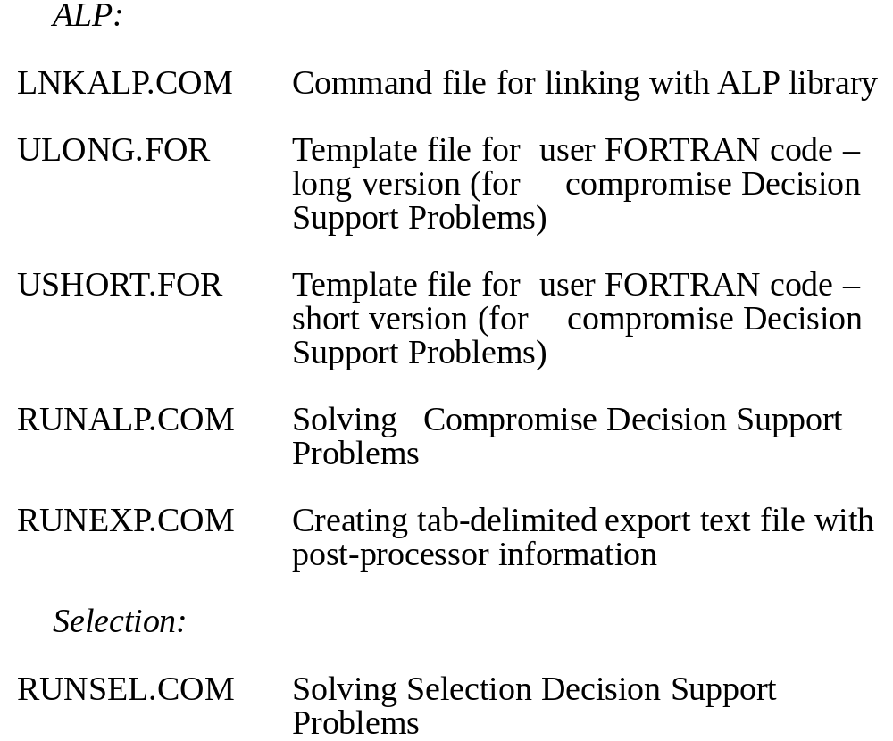
Files

Slide 8
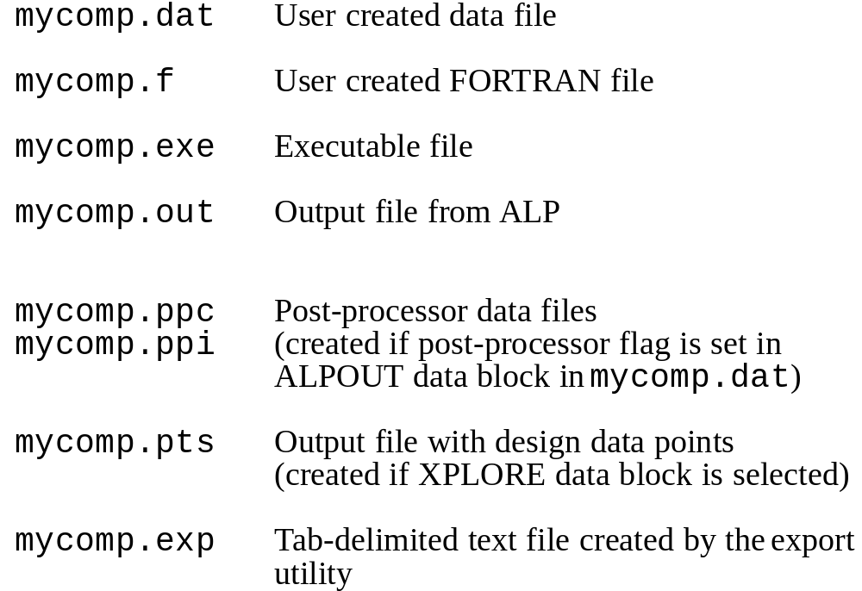
DSIDES Files
2013 – SRL@OU
mycomp.exp → mycomp.xls

Slide 9
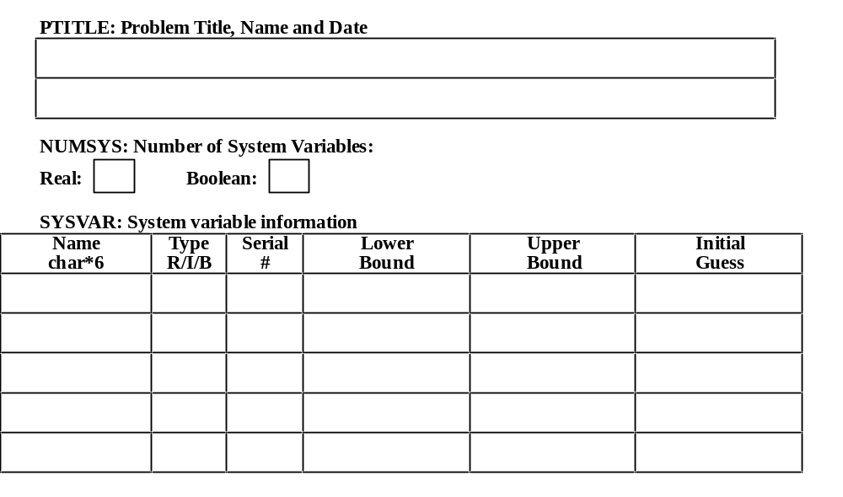
DATA

Slide 10
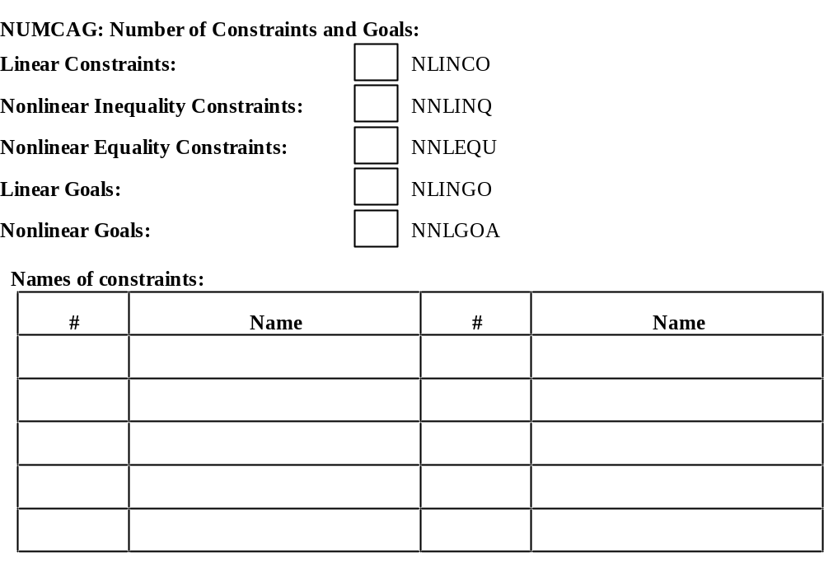
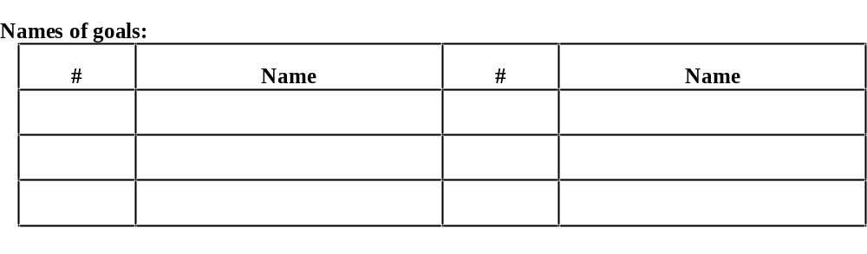
DATA

Slide 11
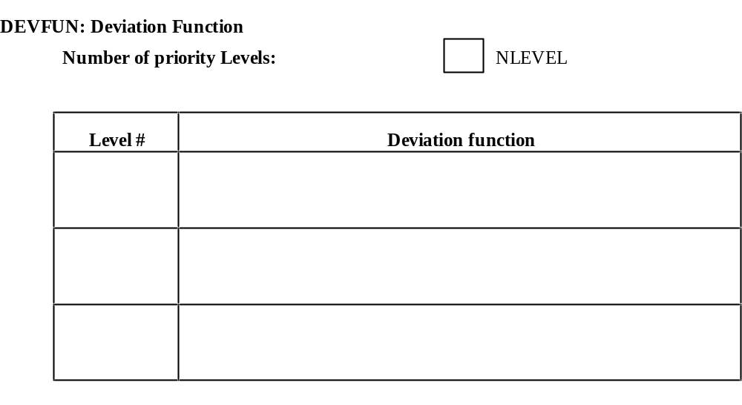
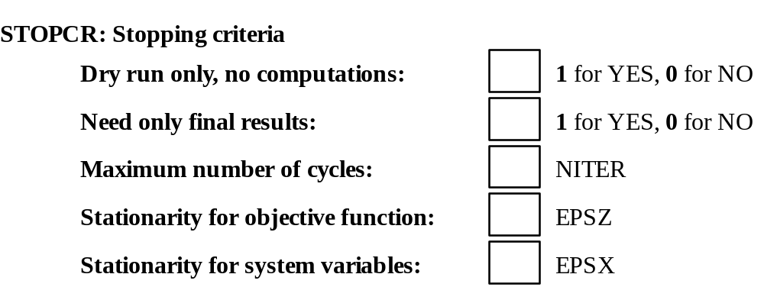
DATA

